Slide 1

Introducing Classes, Objects, and Methods
All classes have constructors, whether you define one or not, because Java automatically provides a default constructor.
In this case, non-initialized member variables have their default values, which are zero, null, and false, for numeric types, reference types, and booleans, respectively.
Once you define your own constructor, the default constructor is no longer used.

Slide 2
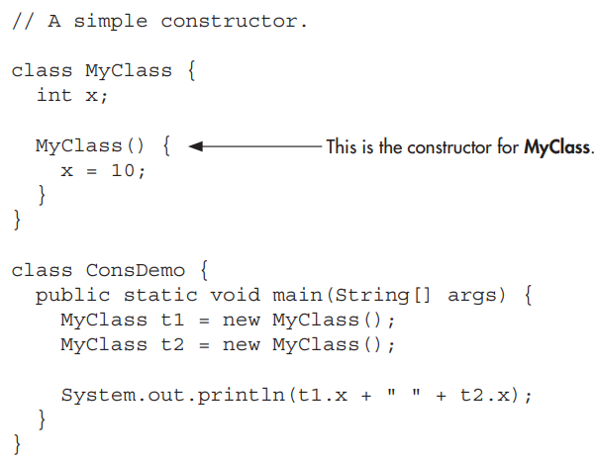
Introducing Classes, Objects, and Methods

Slide 3

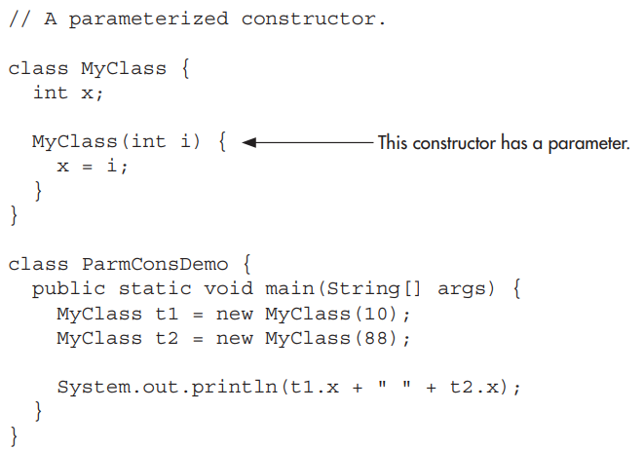
Introducing Classes, Objects, and Methods

Slide 4
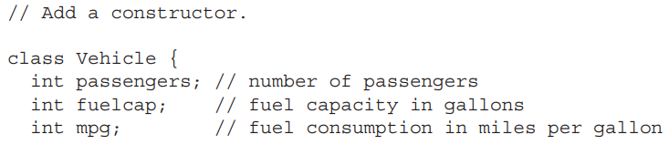
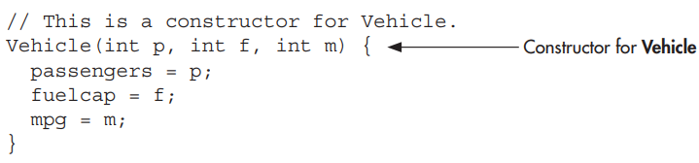
Introducing Classes, Objects, and Methods

Slide 5
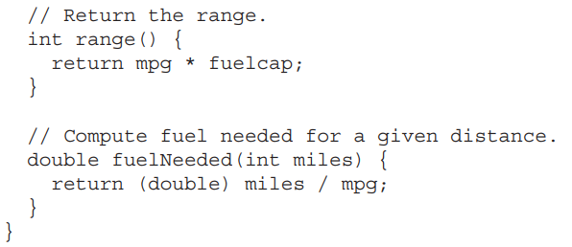
Introducing Classes, Objects, and Methods

Slide 6
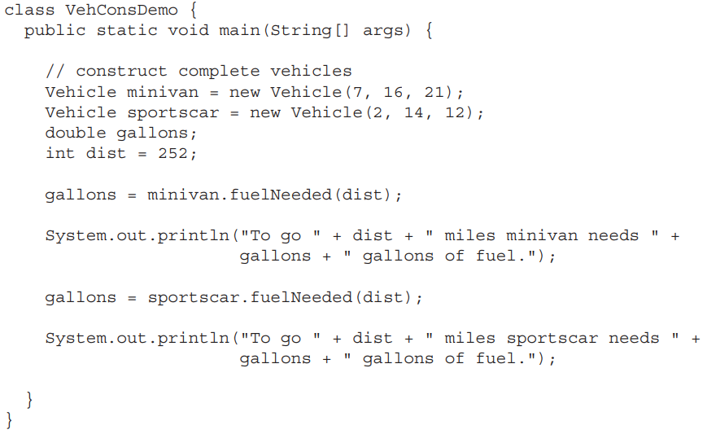
Introducing Classes, Objects, and Methods

Slide 7

Introducing Classes, Objects, and Methods
When a method is called, this is automatically passed an implicit argument that is a reference to the invoking object (that is, the object on which the method is called).
This reference is called this.
To understand this, first consider a program that creates a class called Pwr that computes the result of a number raised to some integer power:

Slide 8
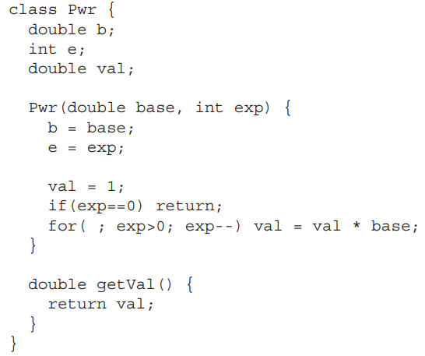
Introducing Classes, Objects, and Methods

Slide 9
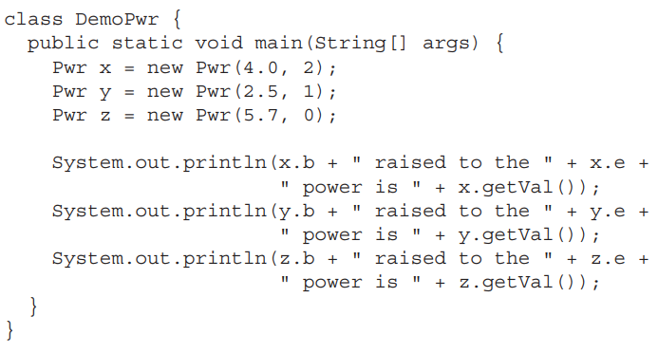
Introducing Classes, Objects, and Methods

Slide 10

Introducing Classes, Objects, and Methods
As you know, within a method, the other members of a class can be accessed directly, without any object or class qualification.
Thus, inside getVal( ), the statement
means that the copy of val associated with the invoking object will be returned.

Slide 11
Introducing Classes, Objects, and Methods
However, the same statement can also be written like this:

Slide 12
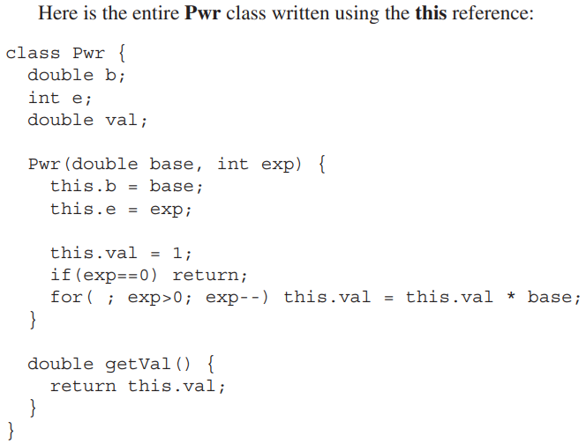
Introducing Classes, Objects, and Methods

Slide 13



More Data Types and Operators
The sample variable holds a reference to the memory allocated by new.

Slide 14

More Data Types and Operators
it is possible to break the preceding declaration in two.
In this case, when sample is first created, it refers to no physical object.
It is only after the second statement executes that sample is linked with an array.

Slide 15
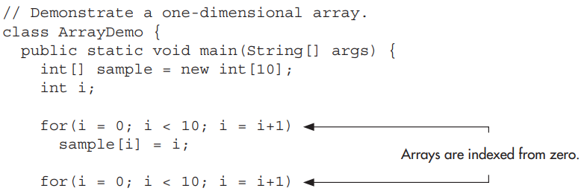
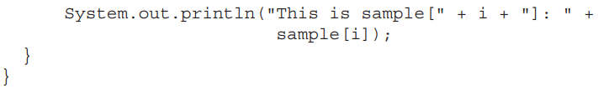
More Data Types and Operators

Slide 16
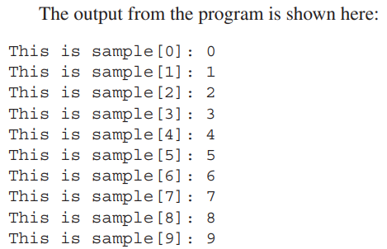
More Data Types and Operators

Slide 17
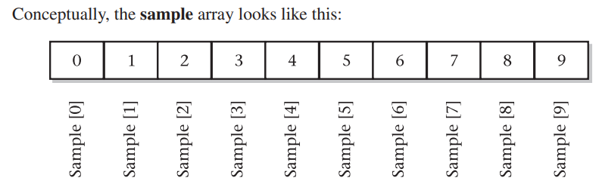
More Data Types and Operators

Slide 18
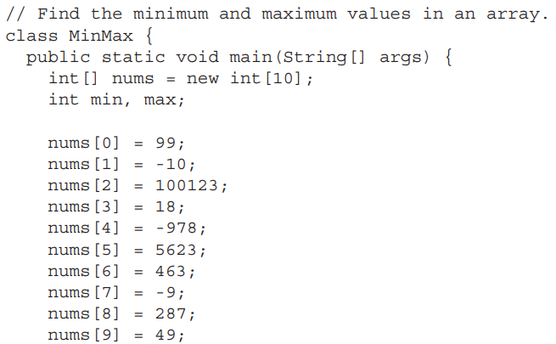
More Data Types and Operators
Assign values to array elements

Slide 19
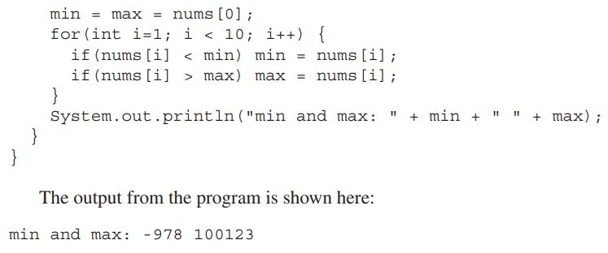
More Data Types and Operators

Slide 20
More Data Types and Operators
In the preceding program, the nums array was given values by hand, using 10 separate assignment statements.
there is an easier way to accomplish this. Arrays can be initialized when they are created.
The general form for initializing a one-dimensional array is shown here:

Slide 21
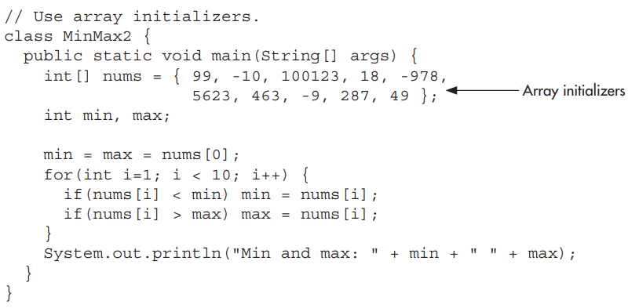
More Data Types and Operators

Slide 22
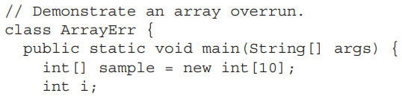
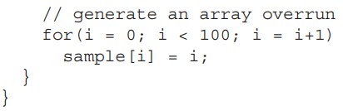
More Data Types and Operators
Array boundaries are strictly enforced in Java; it is a run-time error to overrun or underrun the end of an array.

Slide 23


More Data Types and Operators
In Java, a multidimensional array is an array of arrays.
The simplest form of the multidimensional array is the two-dimensional array.
A two-dimensional array is, in essence, a list of one-dimensional arrays.

Slide 24
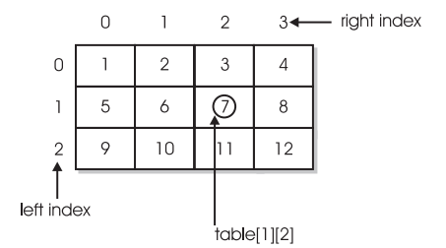
More Data Types and Operators

Slide 25

More Data Types and Operators
When you allocate memory for a multidimensional array, you need to specify only the memory for the first (leftmost) dimension. You can allocate the remaining dimensions separately.
For example, the following code allocates memory for the first dimension of table when it is declared.
It allocates the second dimension manually.

Slide 26
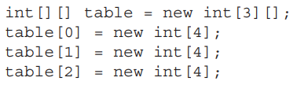
More Data Types and Operators

Slide 27
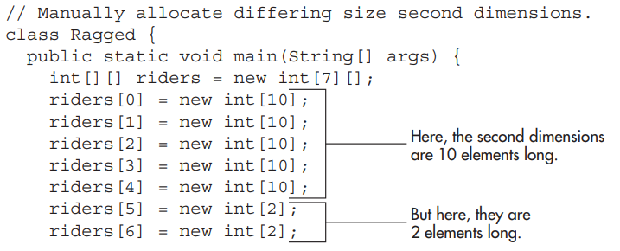
More Data Types and Operators

Slide 28
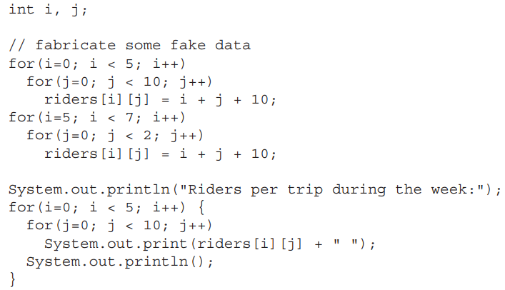
More Data Types and Operators

Slide 29
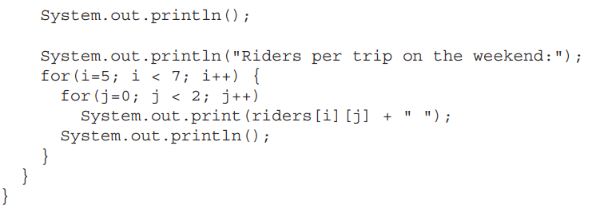
More Data Types and Operators

Slide 30
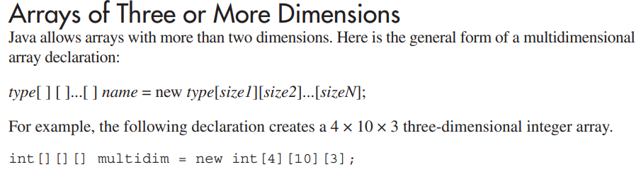
More Data Types and Operators

Slide 31
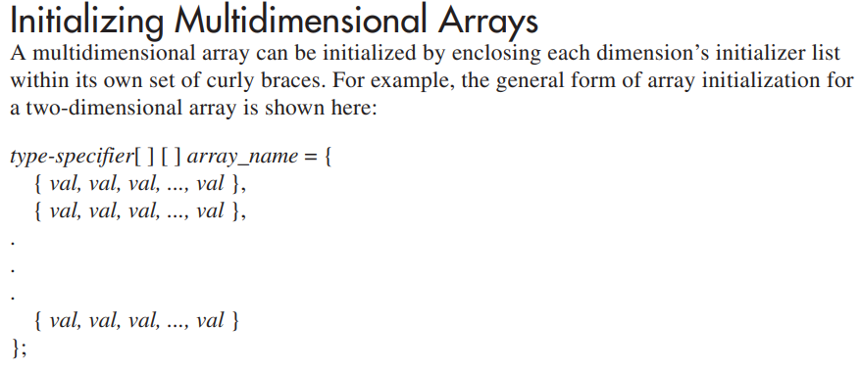
More Data Types and Operators

